Slide 1
My Capstone Project

Slide 2
My guiding question
“How can I safely and efficiently research, plan, and manufacture a Geiger muller counter”
Notes:
I chose to word it like this because I am working with high voltage so safety and planning around it is needed

Slide 3

Safety
High voltage
Common sence
One hand rule
Radioactive substances
Minimizing contact
Safe/small sources
Notes:
So because we are working with high voltage, besides from having common sense, using the one hand rule is a easy way to reduce risk. The One hand rule is to always have one hand behind your back. This stops you from accidently running electricity through your heart which is generally not good.
For radioactive substances Minimizing contact reduces most of the danger since your body can handle a bit of radiation if it’s a quote unquote “safe source”.
But By safe source im talking about alpha emitters in small quantity's. These radiation emitters cannot penetrate the skin so there is little to no risk. And the total emission of the source is similar to what a person living in Squamish would experience by just being housed near a large amount of granite.

Slide 4
overview
Why I chose to do this
Interest in nuclear energy
Interest in high voltage
I saw all the power conversion and management
This is what ive learned blabalblalba everything Ive compiled here
Resources
Most helpful stuff why I found it helpful
Mit thing cause it inspired me in the first place but it also gave a false sence of security
Theory
Ionizing radiation
Geiger-muller tube
Dc-dc power converters
Oneshot generation
Circuit protection
Planning
High level overview (block diagram)
Development
SPICE program
Kicad
(video)
Testing
(pictures)
Manufacture
Pcb design
assembly
sources

Slide 5
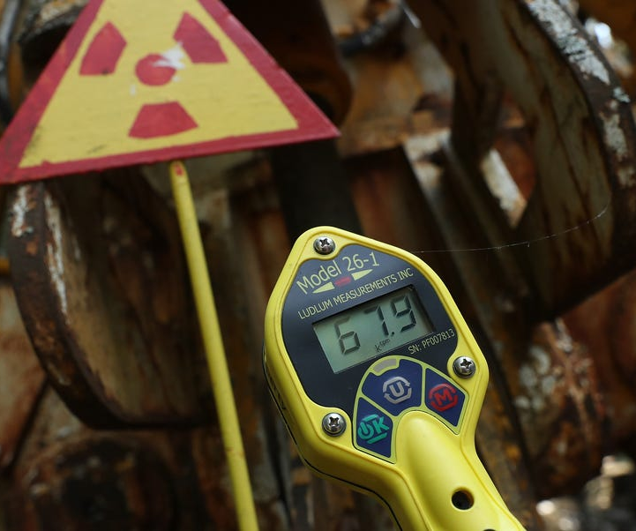
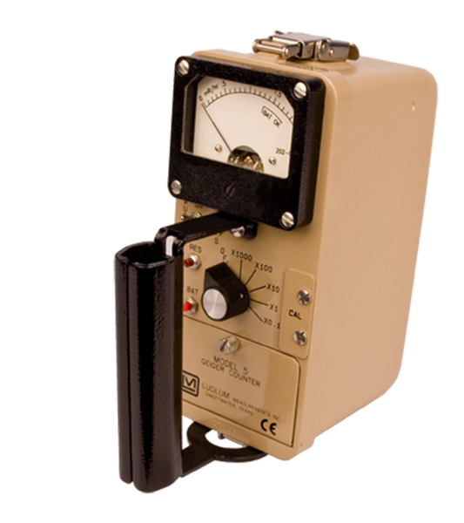

What is my project
Notes:
My project is a Geiger-muller counter. Using a sensor that is super sensitive to radioactive particles it detects radiation and lets out a distinct click sound ( ) . It was first invented in 1908 and later put into production in 1928. During the cold war Geiger counters were used extensively in America and Russia and were sometimes distributed to citizens in case of a nuclear event.

Slide 6



Why
electrical engineer
passion for building and learning
Develops skills
Notes:
Why did I choose to do this project. I chose this as I was working on this as a hobby before the capstone project started, and I had already put a lot of time into researching this. I also saw this as an opportunity to develop my engineering skills incase, I get into an engineering school and I have liked building and working with my hands since I was little so doing this helped me continue to develop a bunch of skills like soldering, welding, and assembling circuits.

Slide 7
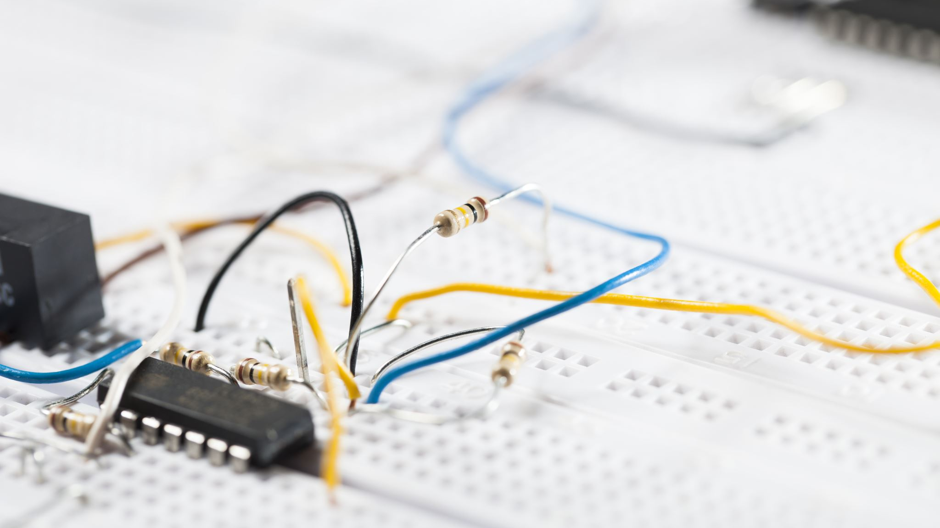
Field specific skills that I learned
Notes:
These are some skills that I learned through this project that are more focused towards electrical engineering

Slide 8
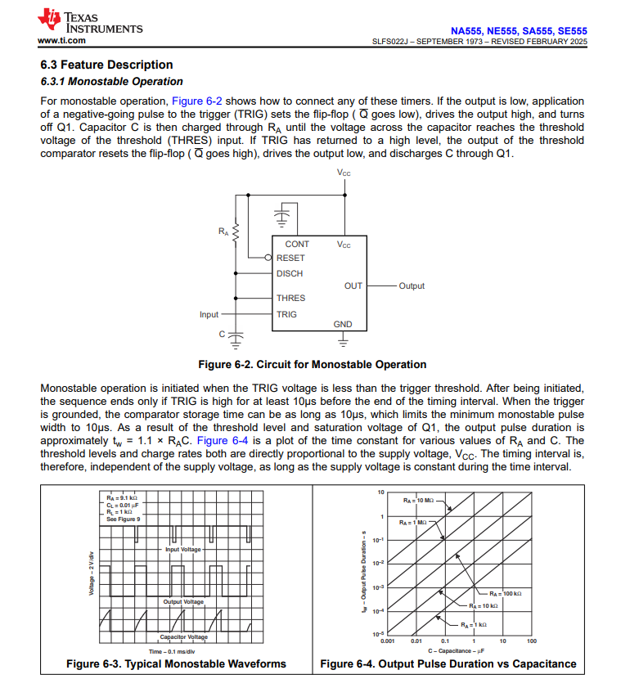
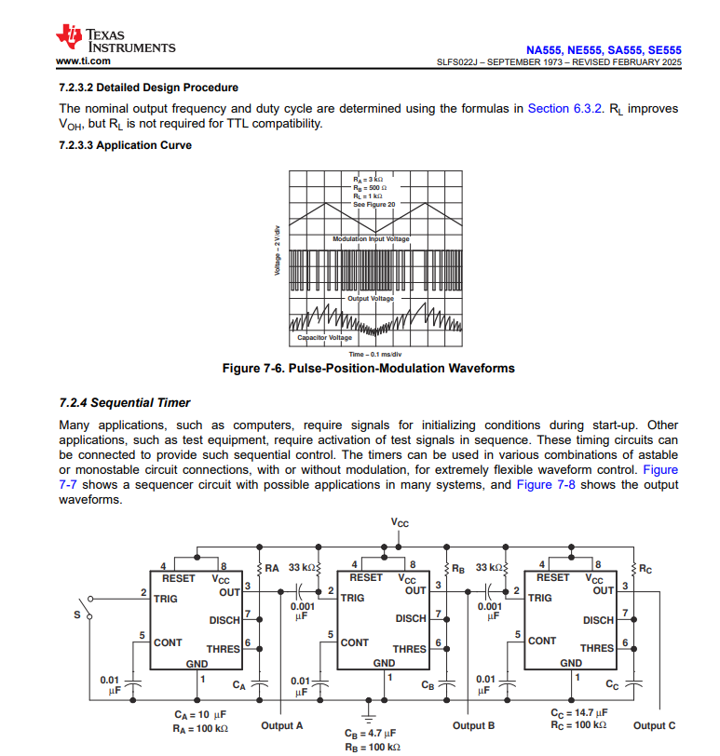
Reading technical documentation
Notes:
Reading technical documentation is essential to understanding the parts, functions and tolerances of the parts you are working with.

Slide 9
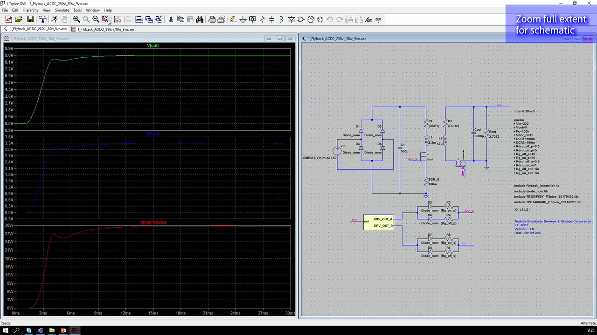
SPICE simulation software
Notes:
Spice simulation software is a type of program used to build, test and simulate circuits. It is often used by electrical engineer students
Before building the physical circuit. developing or prototyping circuits on programs like lt spice cutdown on development costs and it lest you to make mistakes without too much worry

Slide 10
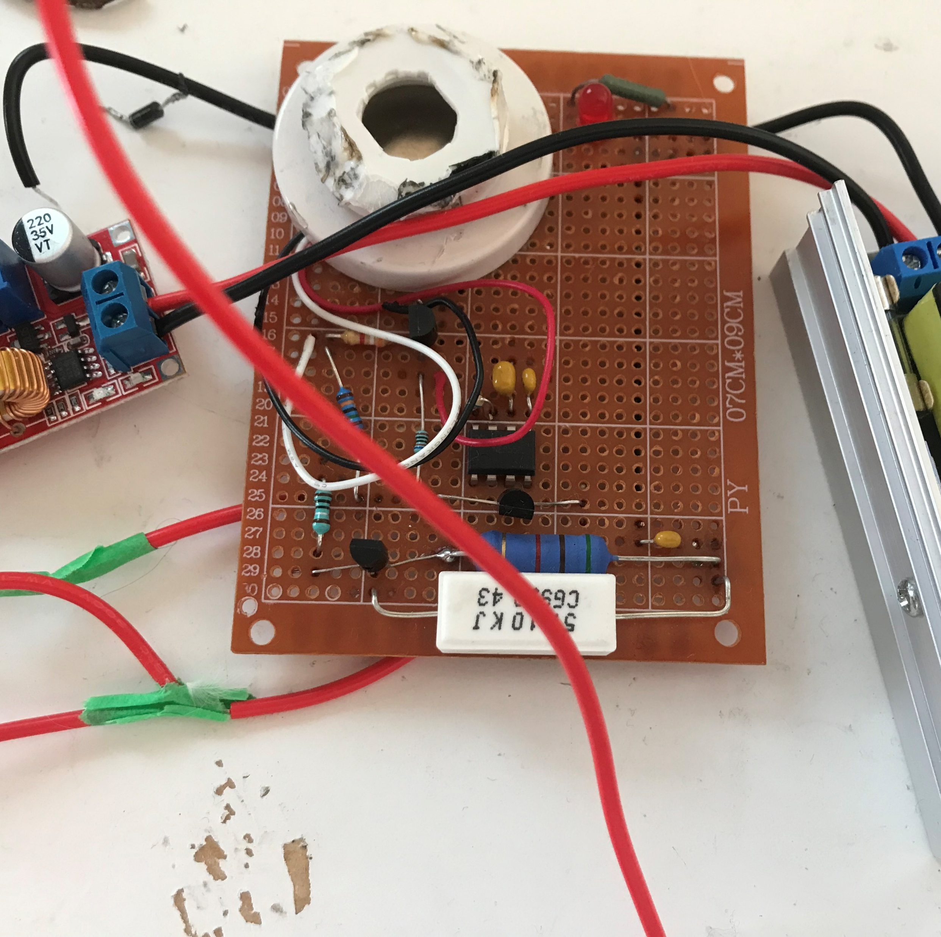
prototyping
Notes:
Prototyping before creating permanent circuit boards allows you to test your simulated circuits in the realworld. This is important because actual parts act slightly differently and can change due to things like heat or pressure. Its also cheaper to mess up on this instead of a full-fledged printed circuit board

Slide 11
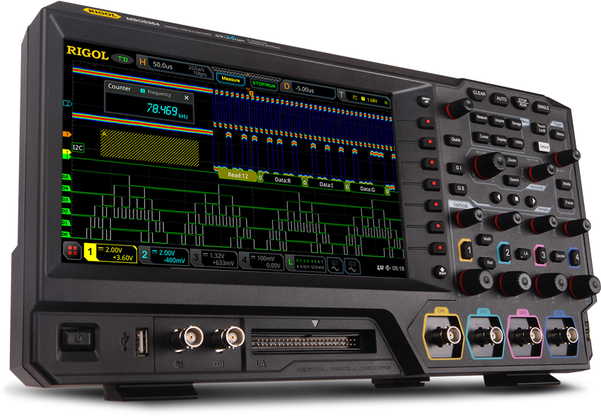
Circuit testing
Oscilloscope
Notes:
Using testing gear helps you analyze the mistakes after prototyping. Here is a oscilloscope and it represents stuff on a graph. Its very helpful for trouble shooting weird signals or interference.

Slide 12
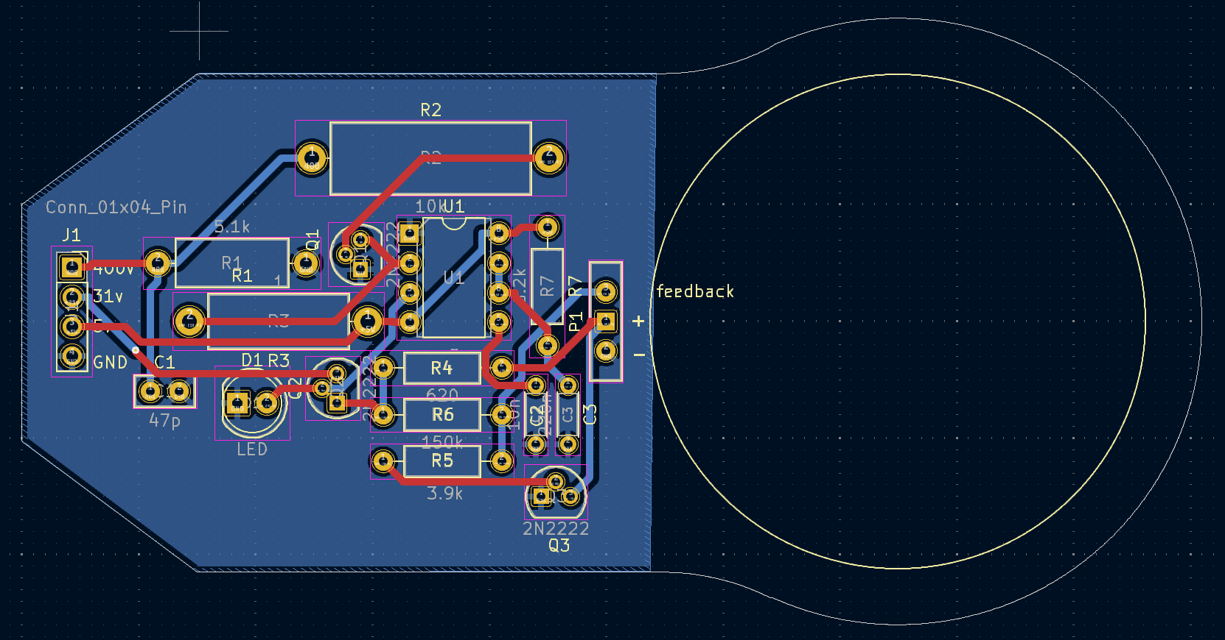
Pcb design software
Notes:
Pcb Desing software allows me to create printed circuit boards where you can easily mount your components and finalize a product. It also has tools for routing traces, plotting components, and preventing noise.

Slide 13
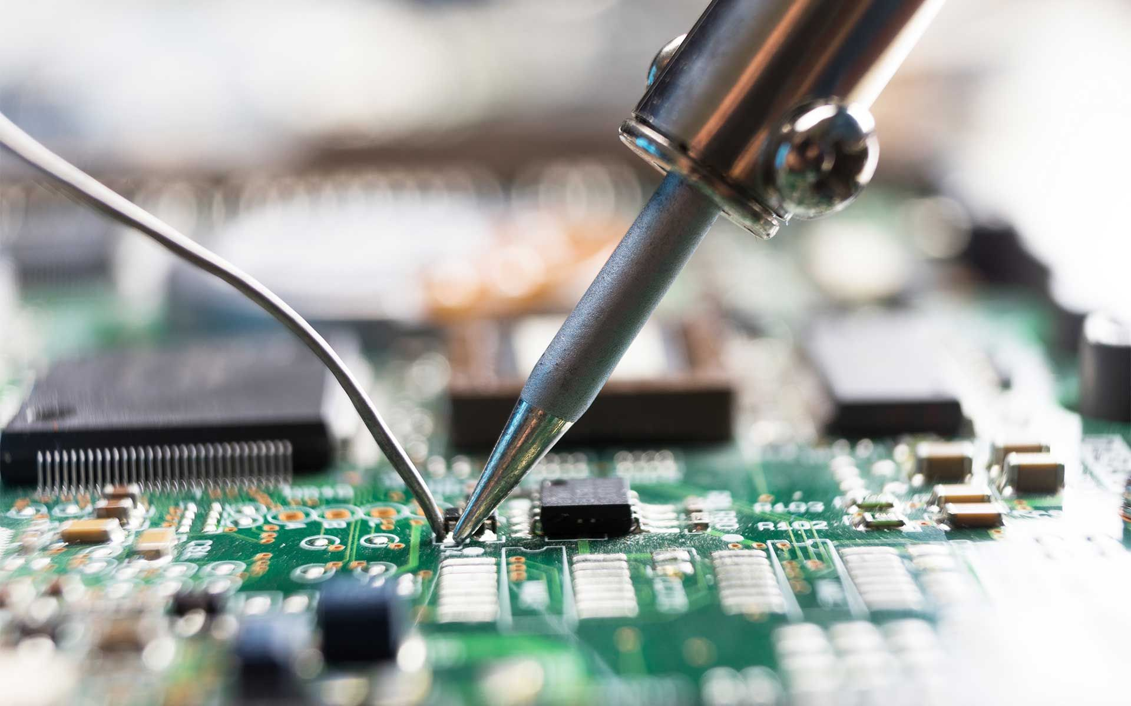
soldering
Notes:
soldering is an essential to know as it lets you actually put together circuits, so developing this skill early will make things easier in the long run.

Slide 14
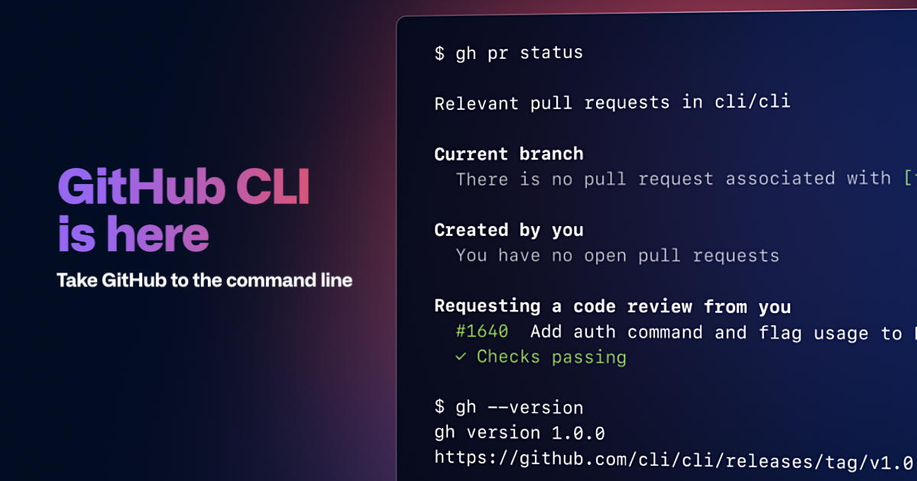
Notes:
Using GitHub is industry standard for a lot of engineering so learning to use their CLI and storing my project files, sources, and documents there, was good practice.

Slide 15
Physical project section

Slide 16
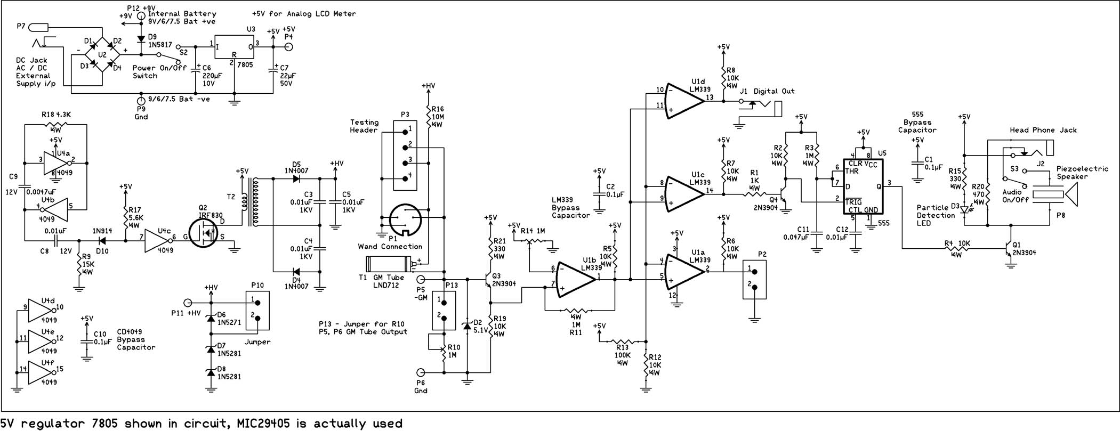
Notes:
I started with asimple, basic block diagram, because it can be overwhelming to look at something like this:

Slide 17


High voltage dc
(high voltage dc-dc converter block)
*Click*
*Click*
Geiger-muller tube
(trigger mechanism)
*Click*
(Audio system block)
Notes:
So here is the basic idea

Slide 18
Then I completed each block
First: Trigger mechanism
1
Second: Audio system
2
Last: High voltage dc – dc converter
3
Notes:
I did this in order from simplest to most complicated

Slide 19
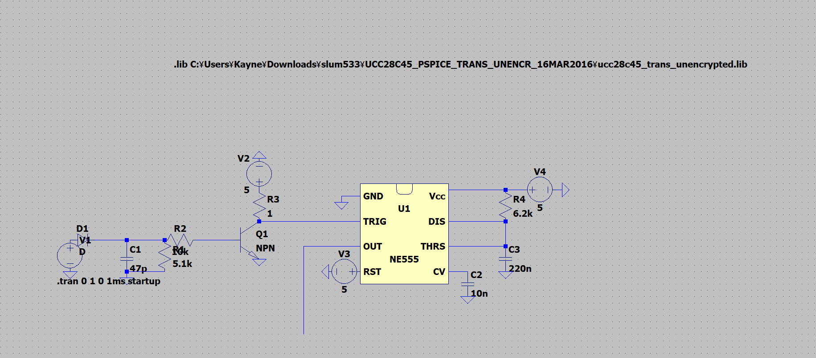
Trigger mechanism
Notes:
This Was also done on the SPICE simulation software mentioned earlier

Slide 20
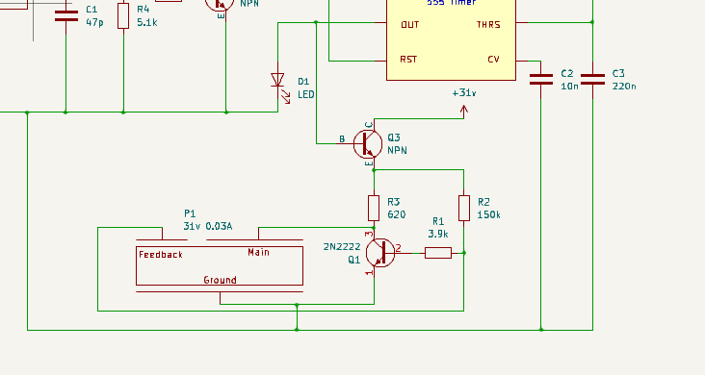
Audio system

Slide 21
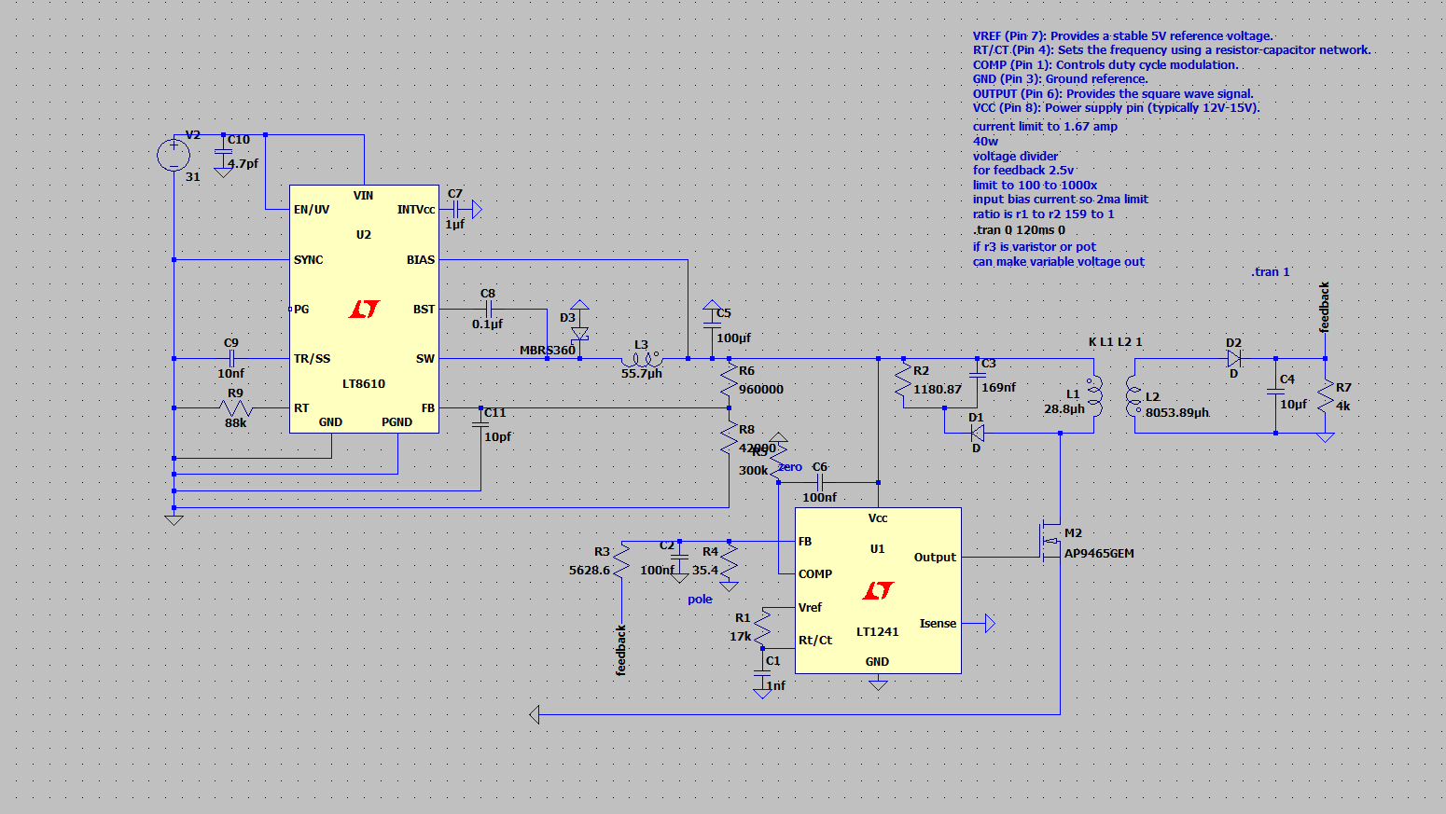
High voltage dc converters
Notes:
This Was also done on the SPICE simulation software

Slide 22
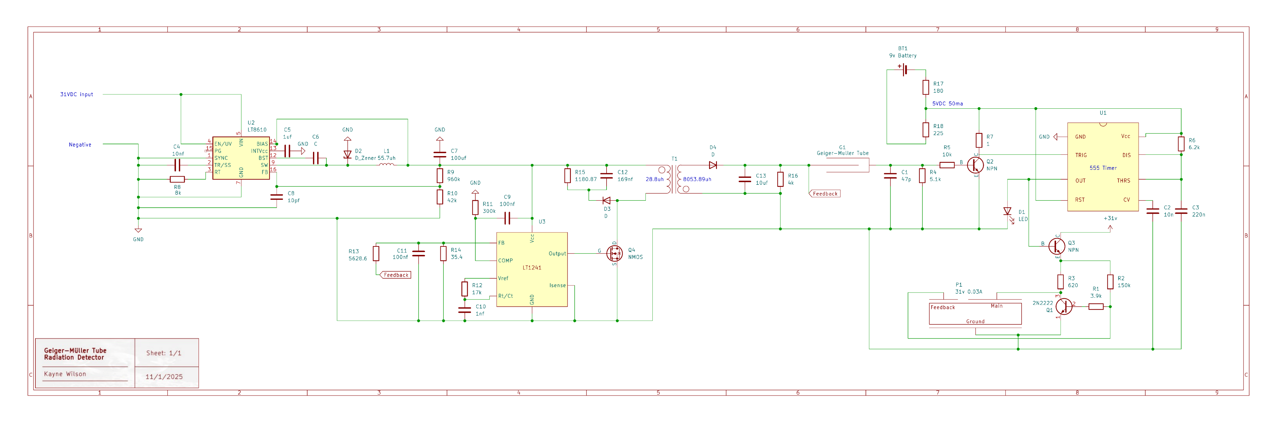
Kicad schematic
Notes:
Here is the completed schematic with all the modules tested and put together.

Slide 23
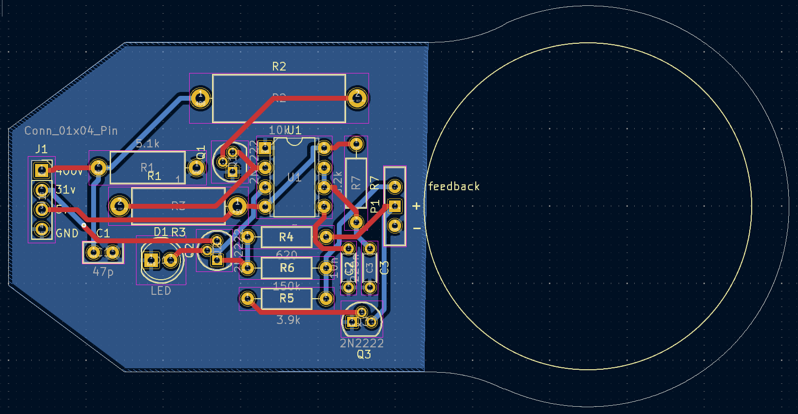
Kicad pcb
Notes:
Here is the completed pcb design ready for manufacture

Slide 24
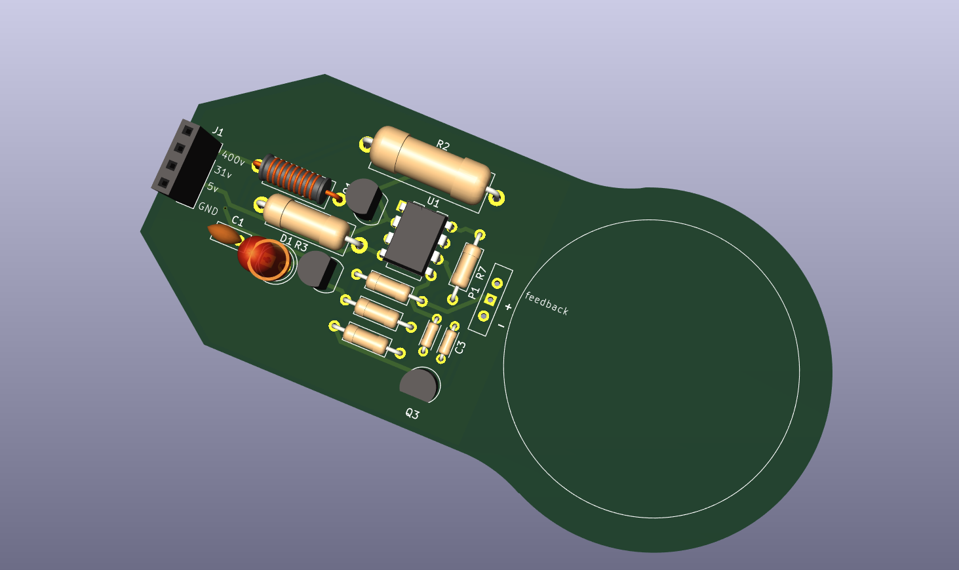
Kicad pcb
Notes:
And heres a populated 3d model of the same board

Slide 25
Final product
Trumps tariffs are fucking me omg. Orange cunt and his whore wife. And that dickhead jdvance what a pussy
Notes:
Once put through manufacture this is what I got

Slide 26

sources
Geiger_Muller_Build: all the resources and websites + project files for Geiger counter. (n.d.). GitHub. https://github.com/poypiy/Geiger_Muller_Build
Notes:
Theres around 100 sources so I compiled them on my github.

